Slide 1
Social media templates
Welcome to
Purpose
The templates are created to do the following:
  Educate the community on the challenges the plan is addressing, for example, elements of the public right-of-way.
      Used throughout the planning process, ideally tied to a call-to-action like filling out a survey, interactive maps, etc.
  Invite community members to attend an event or get involved.
      Used before meetings, events, pop-ups, or launching a survey.
Background
These templates were created with Microsoft PowerPoint and can be uploaded to Google Slides via Google Drive. There are elements of the post you will not be able to change to maintain WCAG compliance and brand consistency. Along with each social media graphic is accompanying information that includes captions and additional instructions.

Slide 2
Social media templates
How to use
How to edit the post
Text highlighted in yellow can be customized with information relevant to your project.
How to edit captions and text alternatives
The “Accompanying information” page has sample caption text and alternative text. You can customize the text highlighted in yellow and copy and paste the text directly into your chosen social media platform.
Accessibility Requirement: Many of these templates have text on an image or graphic. When a post image includes text that text must be included in the caption/text section for accessibility purposes. The sample captions provided include existing.
Accessibility Requirement: Alternate text (alt. text) is visible to assistive devices, while image descriptions are in a caption. The use of at least one of these image descriptions is required, best practice is to use both. Most social media platforms have a feature to add alt. text before publishing.
Image descriptions are written into the caption and have the same information as the alt. text.
Learn more about text alternatives like alt. text and image descriptions on page 44 of CMAP’s “Accessible
Engagement Toolkit”
Notes:
LINK TO ACCESSIBLE ENGAGEMENT TOOLKIT: https://cmap.illinois.gov/wp-content/uploads/Accessible-Public-Engagement-Toolkit.pdf

Slide 3
All people in [Jurisdiction] — including people with disabilities — need to be able to use our sidewalks, crosswalks, streets, and parking to get around safely and conveniently. That’s why we’re launching the [Jurisdiction] Accessible Communities Plan to identify where pedestrian areas are not accessible and plan solutions that serve all abilities. To identify the challenges, we need your help! No one knows a neighborhood better than its residents. Go to [Bitly url] to share locations that need improvement, take the survey, and get involved.
Text on a blue background asking, “What makes a community accessible?” Below the question there are two images: one that says, “less of that” and shows a cracked sidewalk, and the other says “more of this” and shows a smooth sidewalk. The graphic contains the Chicago Metropolitan Agency for Planning’s logo and [jurisdiction] logo.

Slide 4
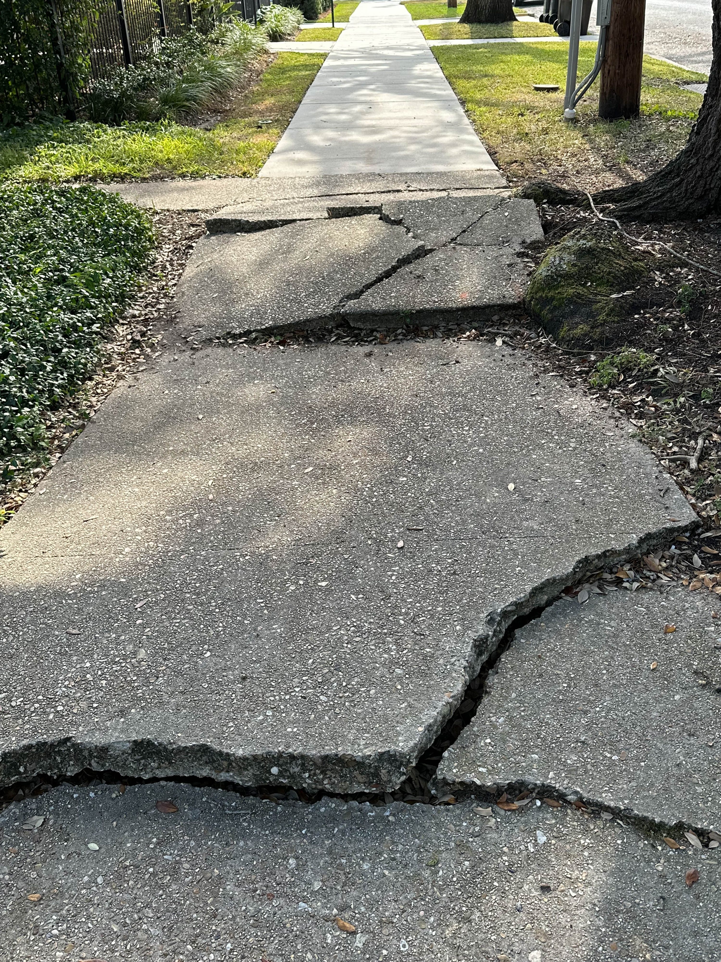
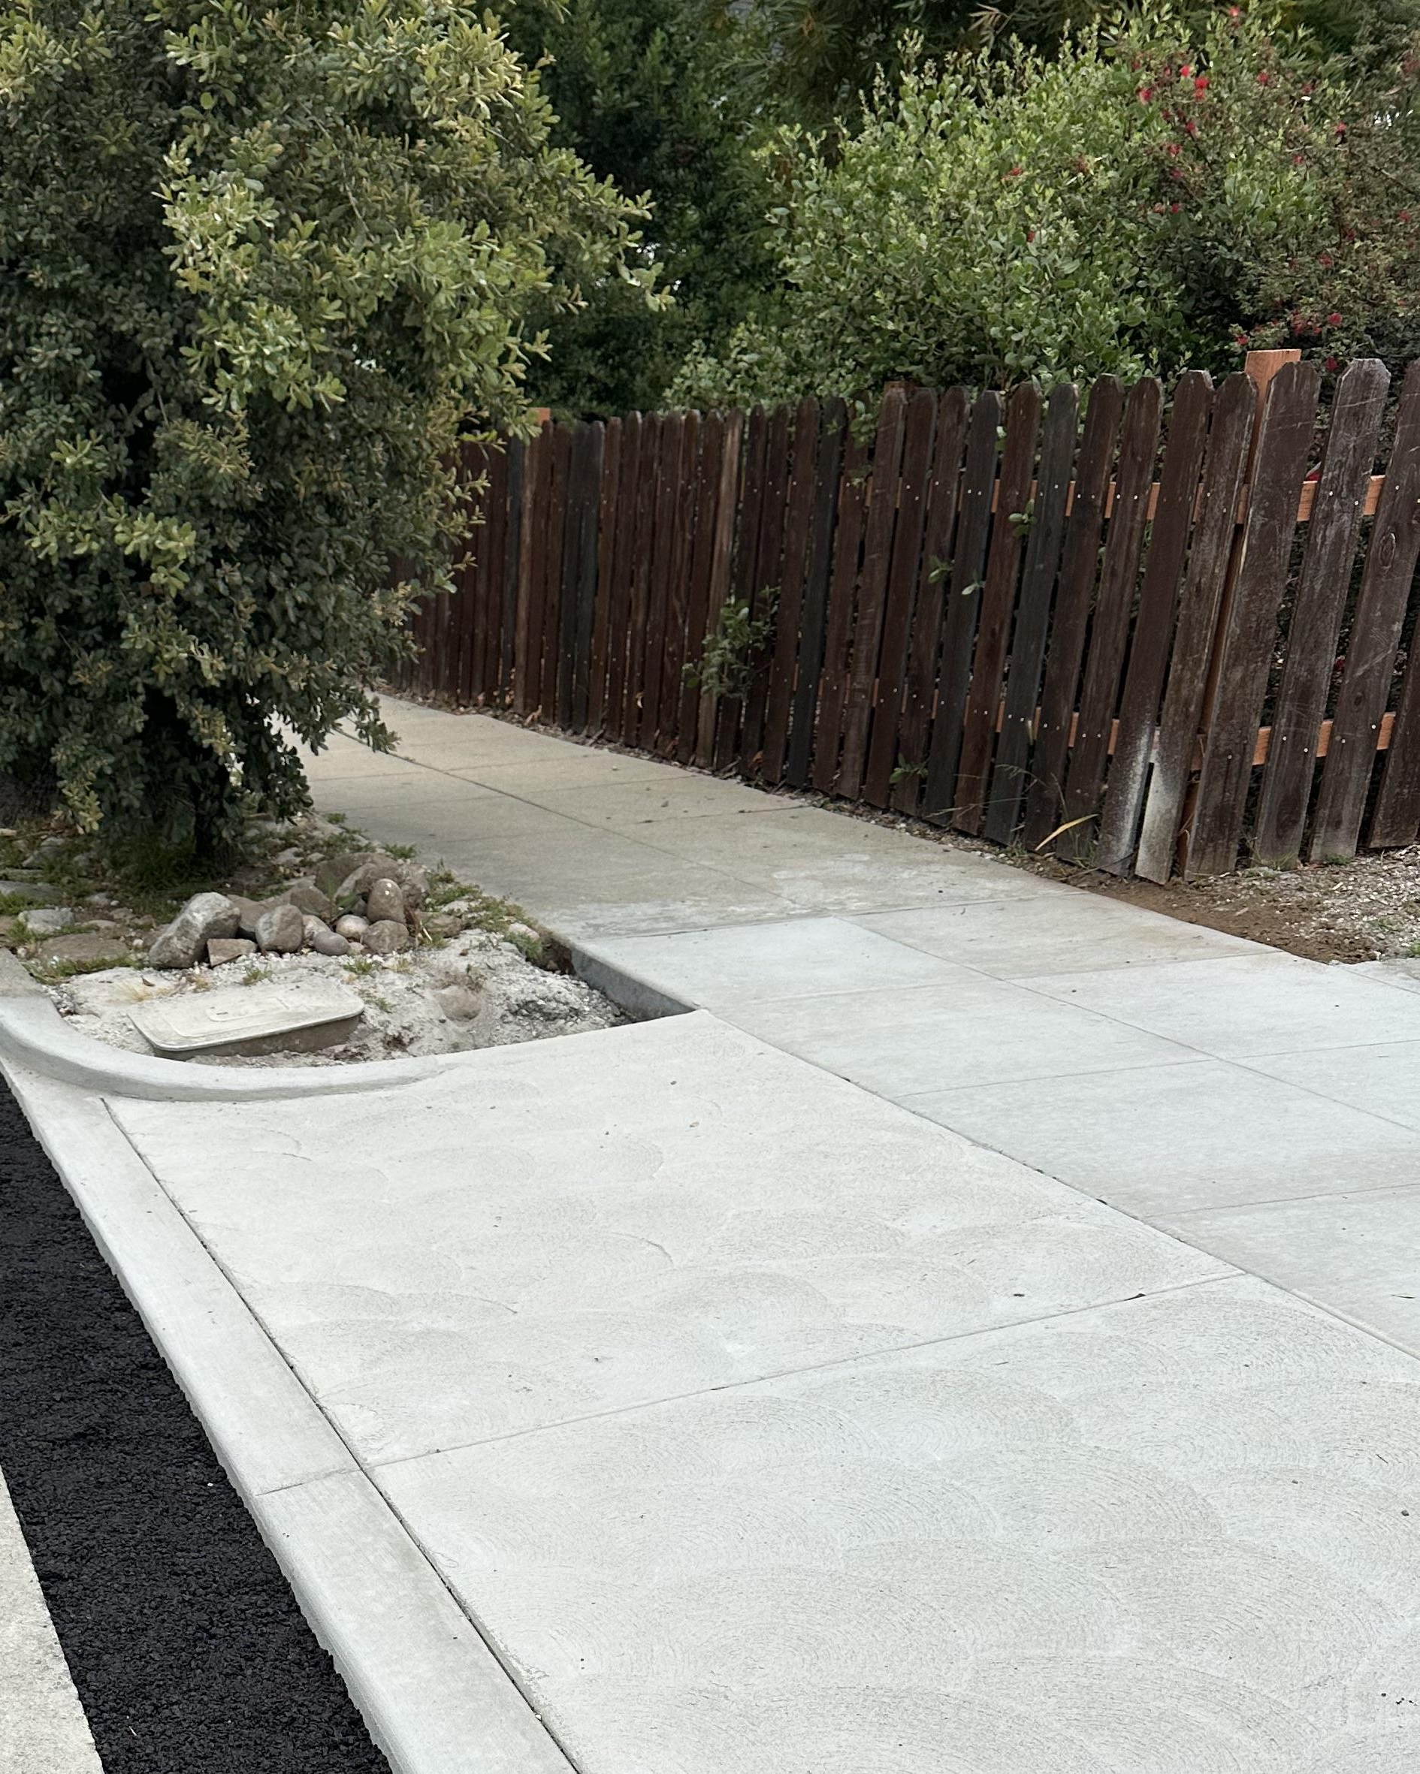
What makes a
community accessible?
Smooth sidewalk
Cracked sidewalk
Delete this box and replace with your jurisdiction’s logo

Slide 5
Join us [event information] to share your experience on sidewalks and crosswalks for the [Jurisdiction] Accessible Neighborhoods plan. [exciting list of what is provided if relevant (i.e., refreshments, family friendly activities] will be provided. The [name of jurisdiction] Accessible Community Plan will identify where pedestrian areas are not accessible and plan solutions that serve all abilities. Learn more: [short URL]
Please email [email] or call [phone number] by [date] to request access accommodations.
Text atop a cartoon style drawing of a winding road with sidewalks and crosswalks. Zoomed in photos of a crosswalk and curb ramp are called out. Text says, “Join us! Help us plan for accessible sidewalks and streets. [Name of meeting, date, time]. Contact [name] at [email] or [phone] with questions or access requests.

Slide 6
Join us [event information] to share your experience on sidewalks and crosswalks for the [Jurisdiction] Accessible Neighborhoods plan. [exciting list of what is provided if relevant (i.e., refreshments, family friendly activities] will be provided. The [name of jurisdiction] Accessible Community Plan will identify where pedestrian areas are not accessible and plan solutions that serve all abilities. Learn more: [short URL]
Please email [email] or call [phone number] by [date] to request access accommodations.
Text atop a cartoon style drawing of a winding road with sidewalks and crosswalks. Zoomed in photos of a crosswalk and curb ramp are called out. Text says, “Join us! Help us plan for accessible sidewalks and streets. [Name of meeting, date, time]. Contact [name] at [email] or [phone] with questions or access requests.

Slide 7
[Name of Meeting]
Date | Time
Contact [name] at [phone] [email] for access requests
Delete this box and replace with your jurisdiction’s logo

