Slide 2
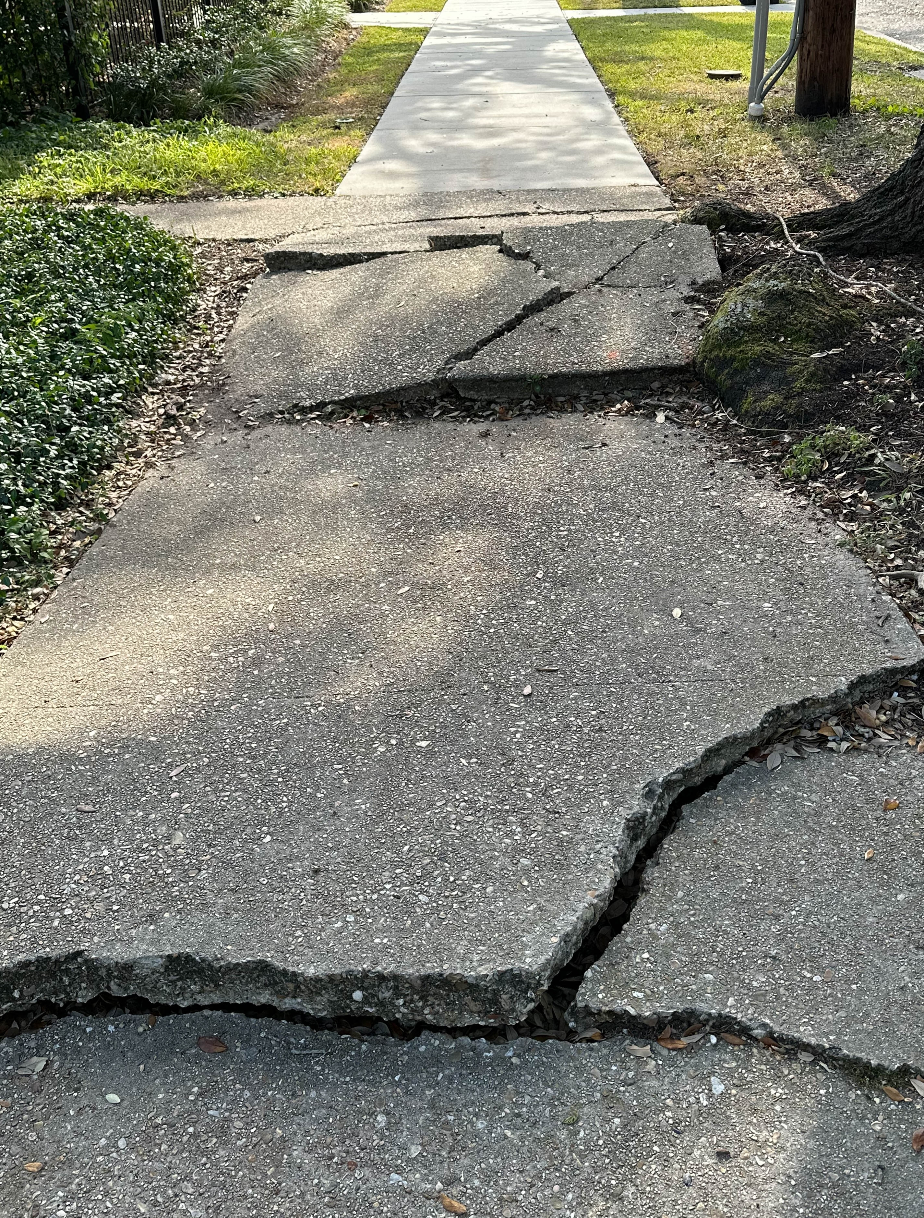
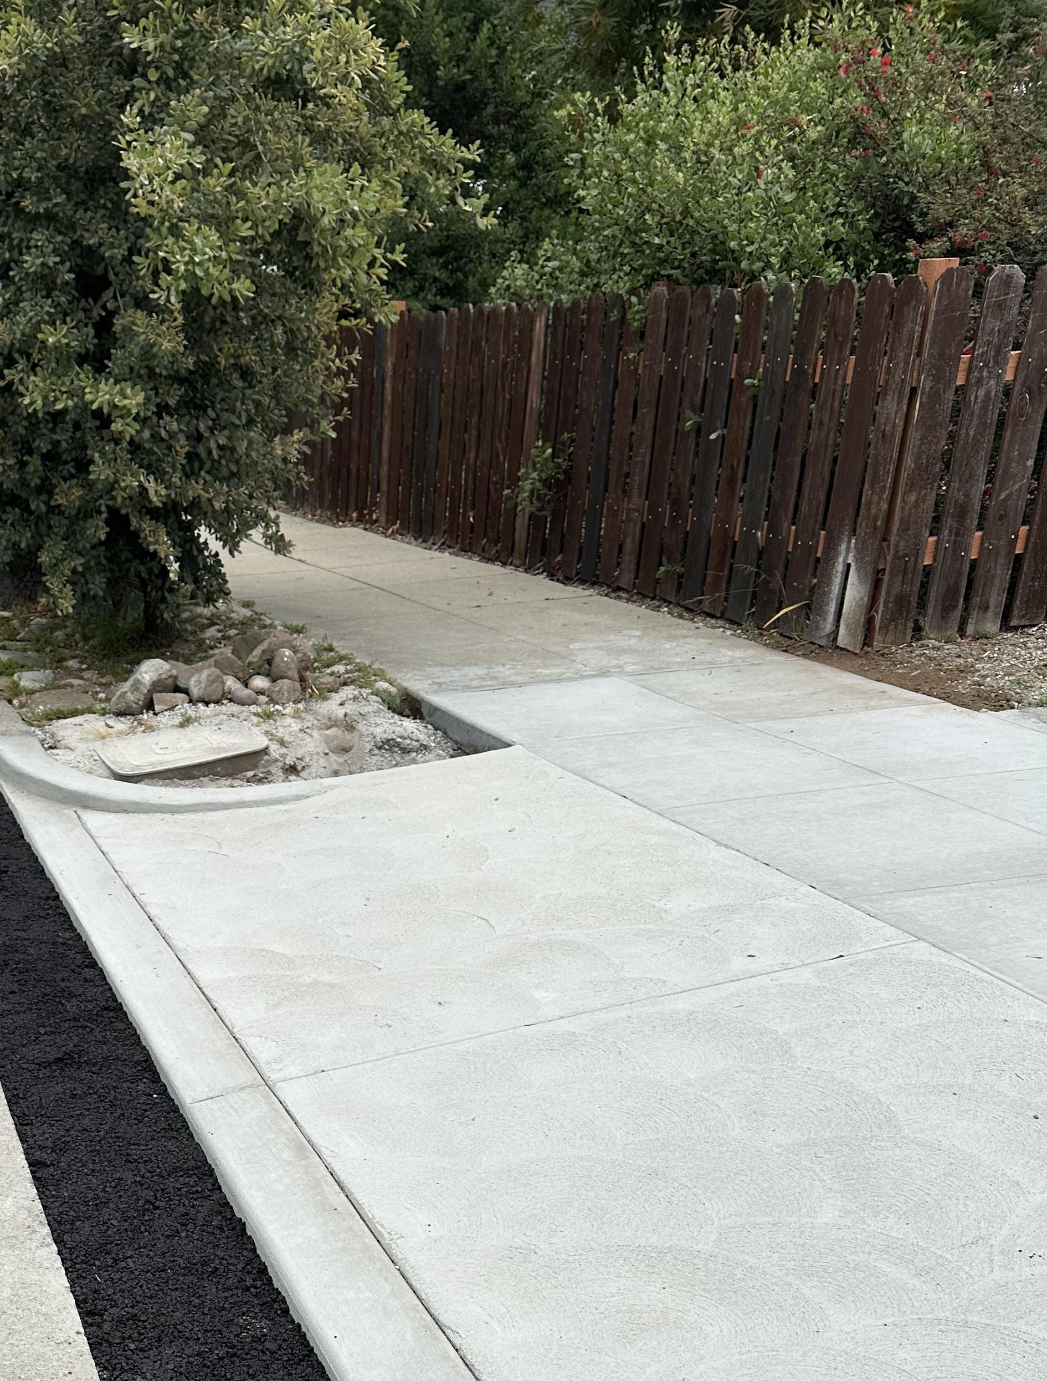
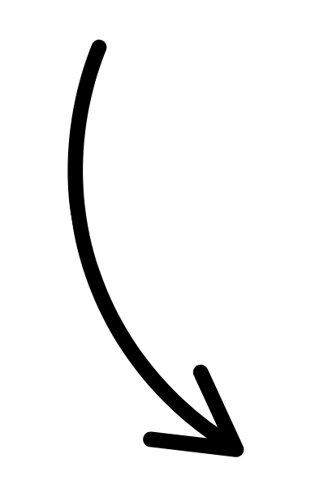
Support the [name of jurisdiction] Accessible Community Plan!
Scan the QR code or visit [enter bit.ly link] to share your experience on sidewalks and crosswalks.
Smooth sidewalks
Delete this box and replace it with a QR code to the project website. Learn how to make a QR code on the “how to use” page
Cracked sidewalks
Delete this box and replace it with your jurisdiction's logo

Slide 3
Support the [name of jurisdiction] Accessible Community Plan!
Scan the QR code or visit [enter bit.ly link] to share your experience on sidewalks and crosswalks.
Smooth sidewalks
Delete this box and replace it with a QR code to the project website. Learn how to make a QR code on the “how to use” page
Cracked sidewalks
Delete this box and replace it with your jurisdiction's logo

